Slide 1

PREDICTION OF MEAN CONTRAST OF SPECKLE IMAGES OF NEMATODE SUSPENSION USING MACHINE LEARNING TECHNIQUES
CP302 – CAPSTONE PROJECT
SUPERVISOR :
Dr. Vishwajeet Mehandia
PRESENTED BY :
Akhil Rathod(2021CHB1364)

Slide 2
Objective
This capstone project explores the application of machine learning models to predict the Speckle contrast values of Nematode suspension (Vinegar eels) subjected to varying their concentrations.
The study provides insights to evaluate microbial motility, health, and response to treatment using these predictive models.
The Regression models and Deep Learning models demonstrates the superior predictive capabilities and the potential of integrating Dynamic Laser Speckle Imaging (DLSI) with ML for advanced biological research.

Slide 3
Introduction
Dynamic Laser Speckle Imaging (DLSI):
Captures microbial activity and motility through light scattering.
Provides speckle patterns reflecting biological activities.
Importance of Study:
Predicts mean contrast to evaluate dynamic responses in suspension under different concentrations with respect to time.
Aids non-invasive, real-time analysis for healthcare and environmental applications.
3. Problem statement
Traditional methods (e.g., RAST) are time-intensive and costly.
ML with DLSI provides a faster, efficient alternative.

Slide 4
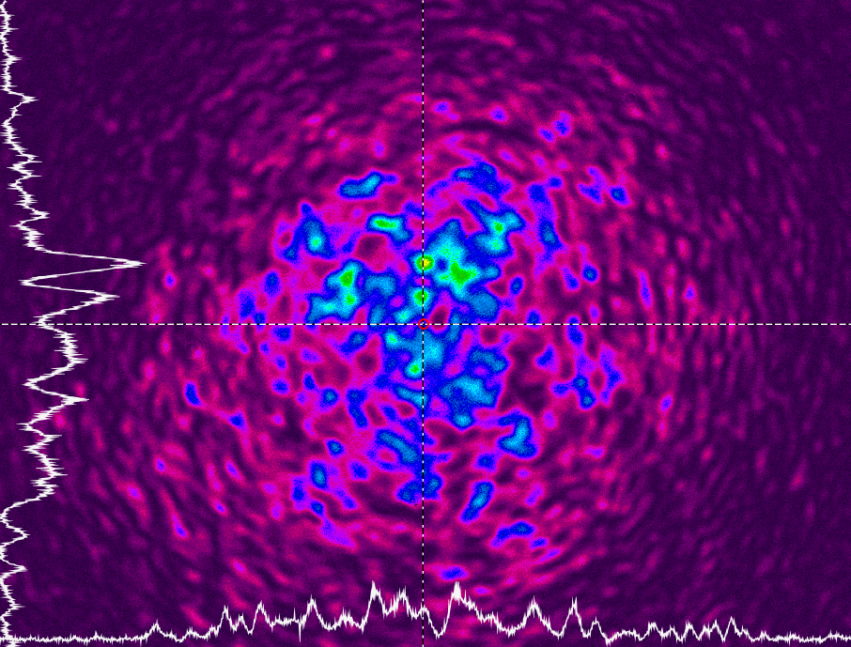
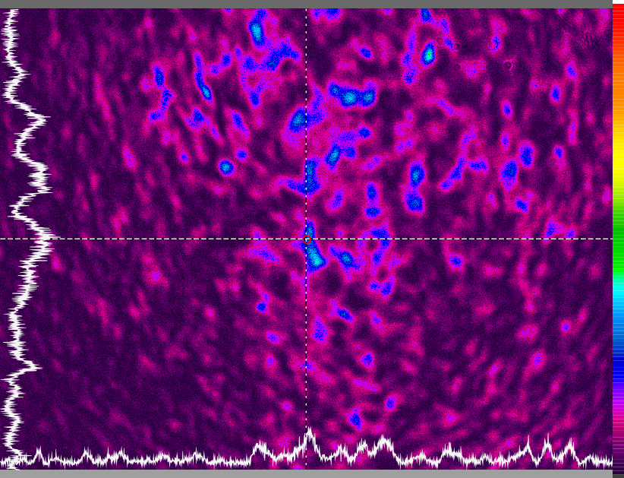
Specification of speckle images
Active Zones Identification 2. Growth Rate Estimation 3. Position of Cluster formation
Both are at time t = 45 min
Both are DLSI of Nematode suspensions
Center Speckle Image at nematode suspension concentration(C1) = 9.04%w/w
Corner Speckle Image at nematode suspension concentration(C1) = 9.04%w/w

Slide 5
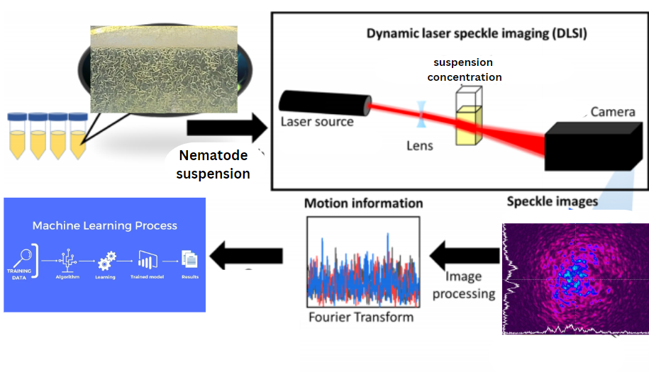
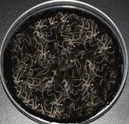
Workflow
https://blog.bugsforgrowers.com/natural-predators/entomopathogenic-nematodes/beneficial-nematodes/how-to-assess-the-viability-of-beneficial-nematodes-before-application/ https://pubs.acs.org/doi/epdf/10.1021/acssensors.0c01238?ref=article_openPDF

Slide 6
ML Pipeline
Exploratory Data Analysis and Feature Engineering
1) Speckle images of nematode suspension (Vinegar Eels) from DLSI at particular concentration.
2) Finding the mean contrast values (Y) of the X for the initial labelling using FIJI software.
3) Applying Fourier transformation(FT) to the X.
These Y’s are used to train our ML model
Input Data (X)
Data Preprocessing includes Image Processing in FIJI software and FT.
After Data preprocessing , X_i’s and Y_i’s are used for training model
Model optimization with Hyperparameter tuning methods
5) Evaluating our ML Model in terms of metrics.
4) Applying Machine Learning Model.

Slide 7
Methodology
Step 1: Image processing: (Data Preprocessing)
Using FIJI software to label and preprocess the speckle images (input data).
Apply Fourier Transform (FT) to extract frequency domain features.
ROI (Regions of Interest) method of 10px * 10px (10px = 0.265cm) to calculate mean contrast (Output) for center and corner speckle images (Input).
Step 2: Model Training:
Linear Regression, Random Forest, Decision tree , Support vector and Deep learning models are applicable for training with labeled images.
Dataset is splitted into 80% training, 20% testing set in Data preprocessing step.

Slide 8
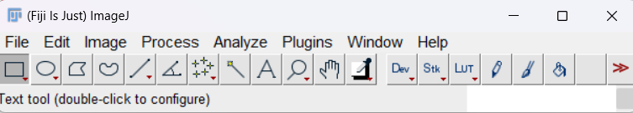
Image Processing in FIJI Software
90 speckle images (X_i’s) for four concentrations of Nematode suspension collected from time t = 0 to t = 90 min.
C1 = 9.04 % , C2 = 4.52 % , C3 = 2.26 % & C4 = 1.13 % are the four concentrations of suspensions respectively.
Three sets of experiment.(i.e. set 1,set 2 , set3)
Target variables (Yi mean’s = sum (Yi’s from set 1, set 2 & set3)/3) for C1,C2,C3& C4.
The Xi’s obtained by preprocessing of speckle images in FIJI.
We can also obtain the concentration of worms (No. of organisms) in FIJI by processing the Raw camera images instead of speckle images to analyze the organism concentration over time.

Slide 9
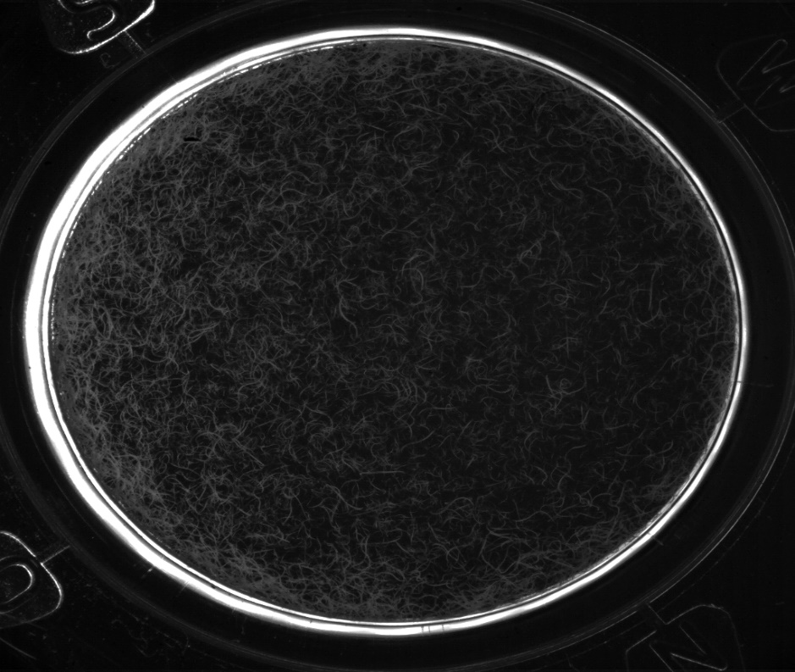
Results and insights from FIJI Software
Raw Camera Image :
Processed Image in FIJI :
Both are at time t = 45 min
Analysis of processed camera images:
The worms are visible as white granular structures and the remaining black surface is the emptiest space in the petri dish environment.
We can draw insights such as concentration of worms ( number of worms ) in the petri dish at each time instant by using FIJI software.

Slide 10
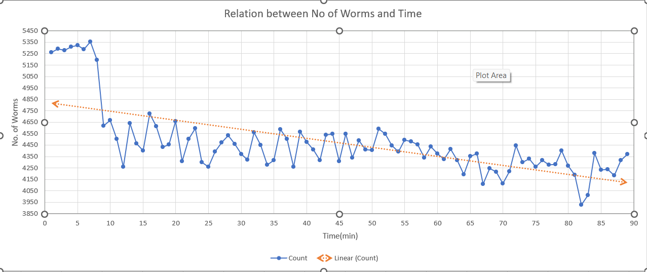
Results and insights from FIJI Software
Analysis of No. of worms at C_3 :
Generally , the concentration of worms are decreasing over time.
1) Uploading the Images(Batch) 2) Converting them into greyscale 3)Adjusting the image threshold 4)Watershed Algorithm 5)Analyse particles gives concentration of worms in FIJI.

Slide 11
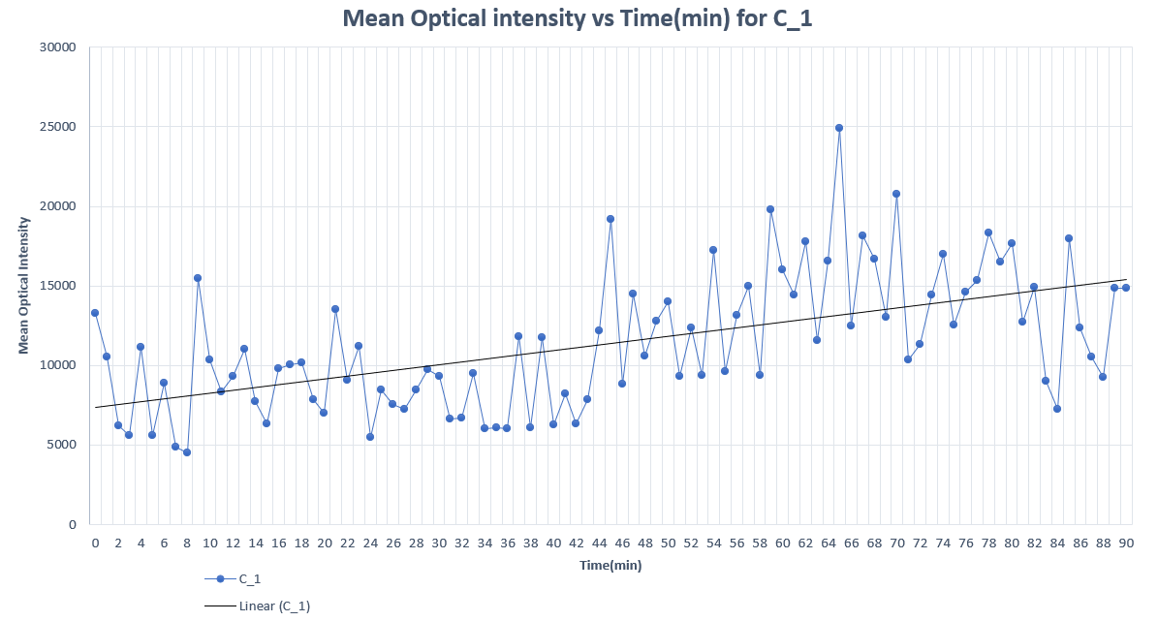
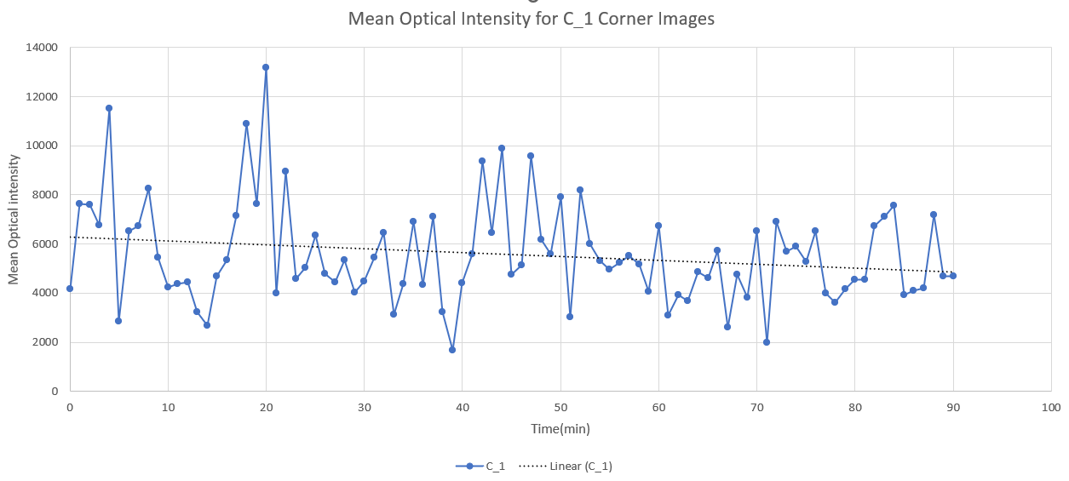
Results and insights from FIJI Software
Center speckle images :
Corner speckle images :
Analysis of Mean Intensity Values:
Center Speckle Images: Intensity (Y) increases with time, indicating organisms are moving toward the center.
Corner Speckle Images: Intensity(Y) decreases, suggesting movement away from the edges.

Slide 12
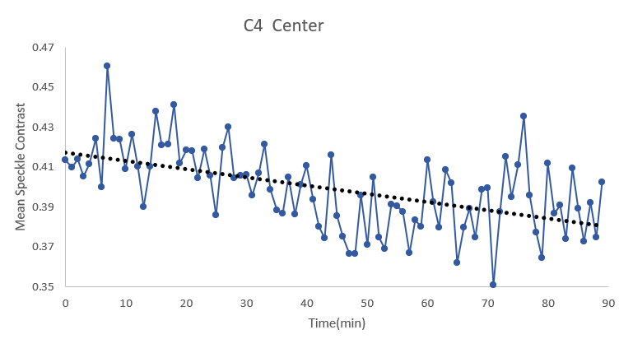
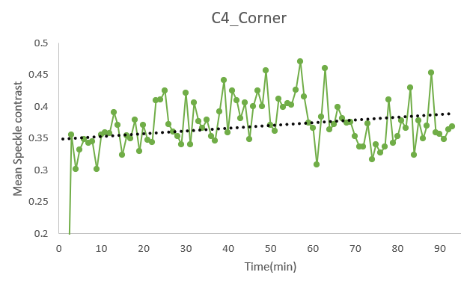
Results and insights from FIJI Software
Center speckle images :
Corner speckle images :
Mean Speckle Contrast : Describes the normalized variation in speckle intensity.
Speckle contrast (K=σi/⟨I⟩)
Higher contrast indicates more static or less dynamic scatterers, while lower contrast suggests greater motion or dynamic scattering.

Slide 13
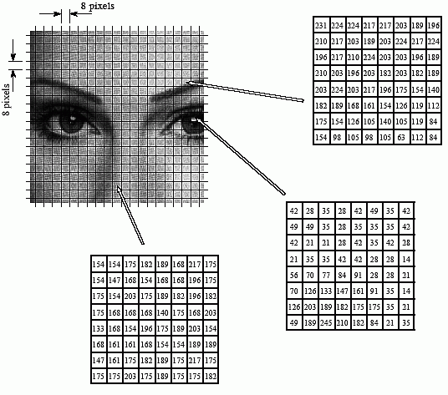
Fourier Transformation
Purpose:
Converts images into the frequency domain, highlighting key patterns.
Reduces noise and enhances ML model accuracy.
Steps:
Apply FFT to speckle images.
Flatten frequency data into feature vectors.
Normalize for use in regression models.
Visuals:
Fourier-transformed speckle image.
Include matrix representation of frequency-domain data.
https://www.dspguide.com/ch27/6.htm)

Slide 14
Machine Learning Approach
Therefore we can say that this is a Regression problem in predicting Mean Contrast values (Y) from Speckle images(X).
Regression Models:
Linear Regression , Support vector , Decision Trees for simple relationships.
Deep Learning models like Artificial Neural Networks(ANN) & 3D Convolutional Neural Networks(3-D CNN) for non-linear, complex data.
Model Validation:
Hyperparameter tuning using GridSearchCV.
Performance metrics: Mean Squared Error (MSE) ,R2 score.

Slide 15
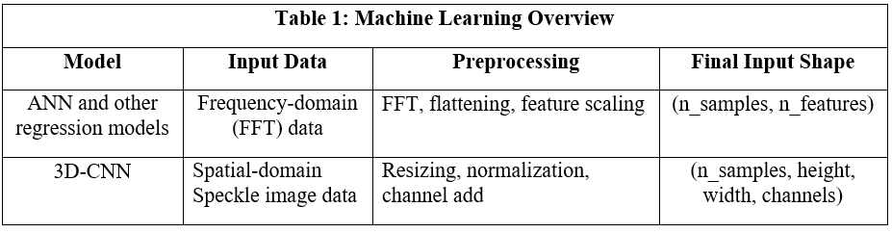
Machine Learning Approach
High Dimensional FFT Features causes problems
Solution: Motion Feature
X=[ X1, X2, X3, X4]
X1 = Mean Change : Average magnitude of pixel changes.
X2 = Standard Change : Variability in pixel changes.
X3 = Max Change : Largest pixel change ( extreme motion).
X4 = Energy change ; Sum of Squared changes ( motion magnitude)

Slide 16
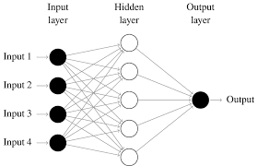
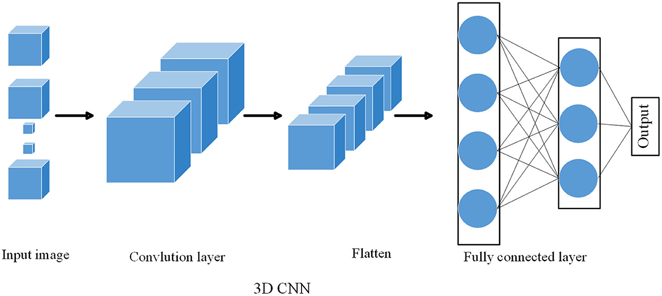
VS

Slide 17
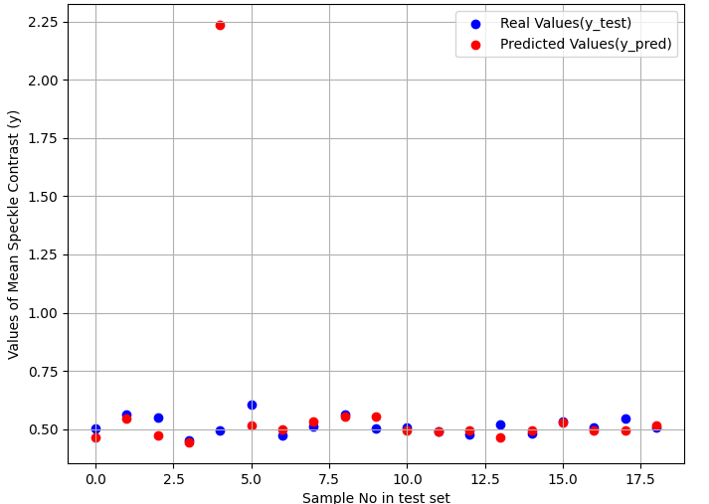
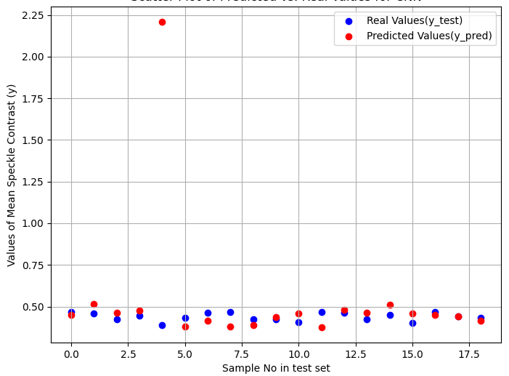
ANN Results
Scatter plots for Center speckle images:
Scatter plots for Corner speckle images:
Both plots are for set 1 of C1

Slide 18
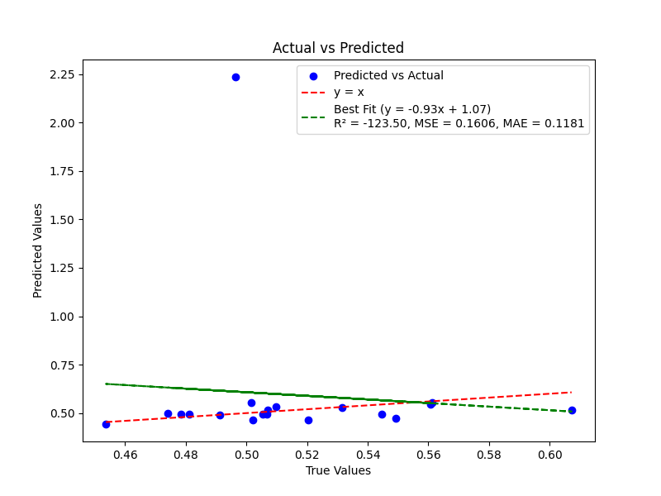
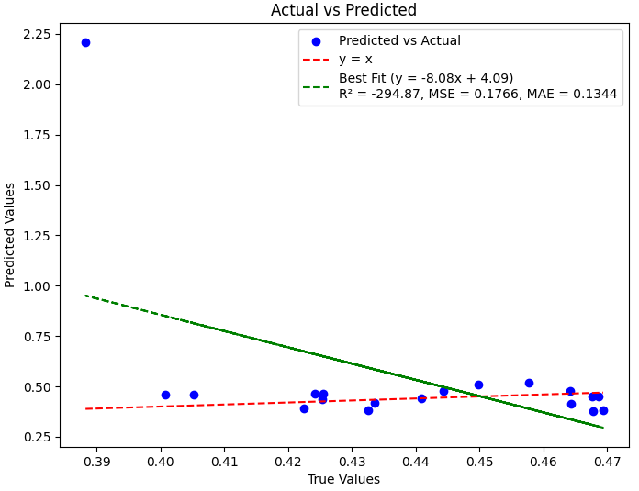
ANN Results
Act vs Pred plots for Center:
Act vs Pred plots for Corner :
Both plots are for set 1 of C1

Slide 19
Results
ANN for Center speckle images:
Experimental Set at particular Concentration. | MSE
C1 set 1 | 0.1606
C1set 2 | 0.0064
C2 set 1 | 0.0085
C2 set 3 | 0.0978
C3 set 1 | 0.0003
C3 set 3 | 0.1224
C4 set 1 | 0.4097
C4 set 3 | 0.1809

Slide 20
Results
ANN for Corner speckle images:
Experimental Set at particular Concentration. | MSE
C1 set 1 | 0.1766
C1set 3 | 0.0452
C2 set 1 | 0.0420
C2 set 3 | 0.0285
C3 set 1 | 0.0005
C3 set 3 | 0.0886
C4 set 1 | 0.0096
C4 set 3 | 0.0048

Slide 21
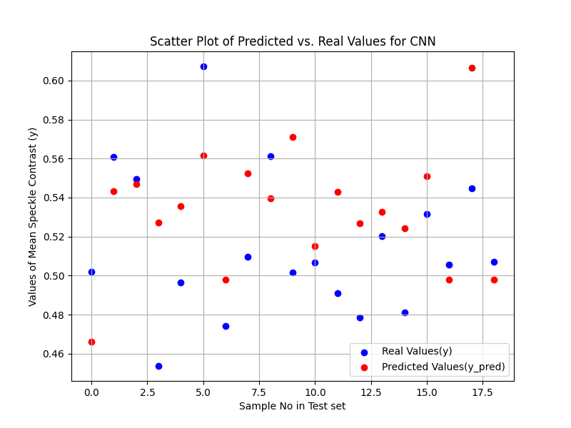
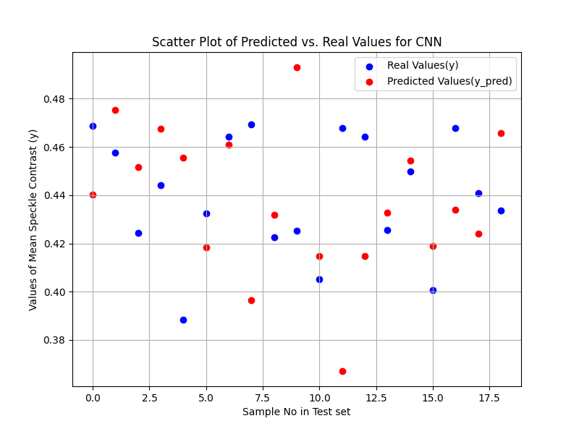
3-D CNN Results
Scatter plots for Center speckle images:
Scatter plots for Corner speckle images:
Both plots are for set 1 of C1

Slide 22
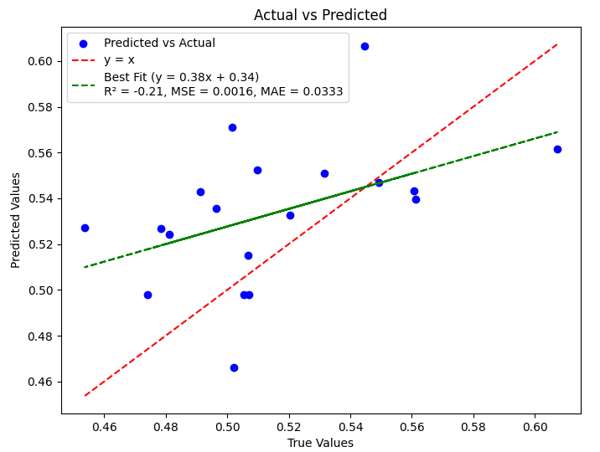
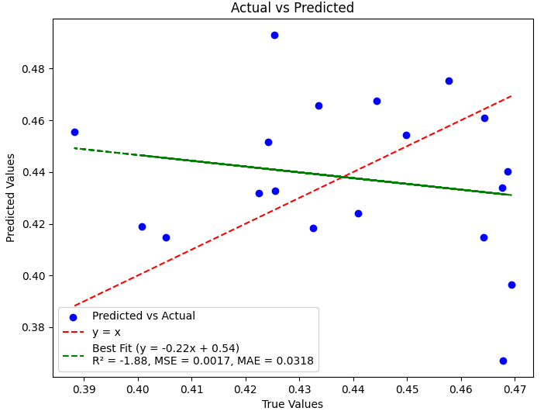
3-D CNN Results
Act vs Pred plots for Center:
Act vs Pred plots for Corner :
Both plots are for set 1 of C1

Slide 23
Results
CNN for Center speckle images:
Experimental Set at particular Concentration. | MSE
C1 set 1 | 0.0016
C1set 2 | 0.0027
C2 set 1 | 0.0006
C2 set 3 | 0.0008
C3 set 1 | 0.0002
C3 set 3 | 0.0003
C4 set 1 | 0.0004
C4 set 3 | 0.0011

Slide 24
Results
CNN for Corner speckle images:
Experimental Set at particular Concentration. | MSE
C1 set 1 | 0.0017
C1set 3 | 0.0012
C2 set 1 | 0.0013
C2 set 3 | 0.0010
C3 set 1 | 0.0004
C3 set 3 | 0.0006
C4 set 1 | 0.0008
C4 set 3 | 0.0201

Slide 25
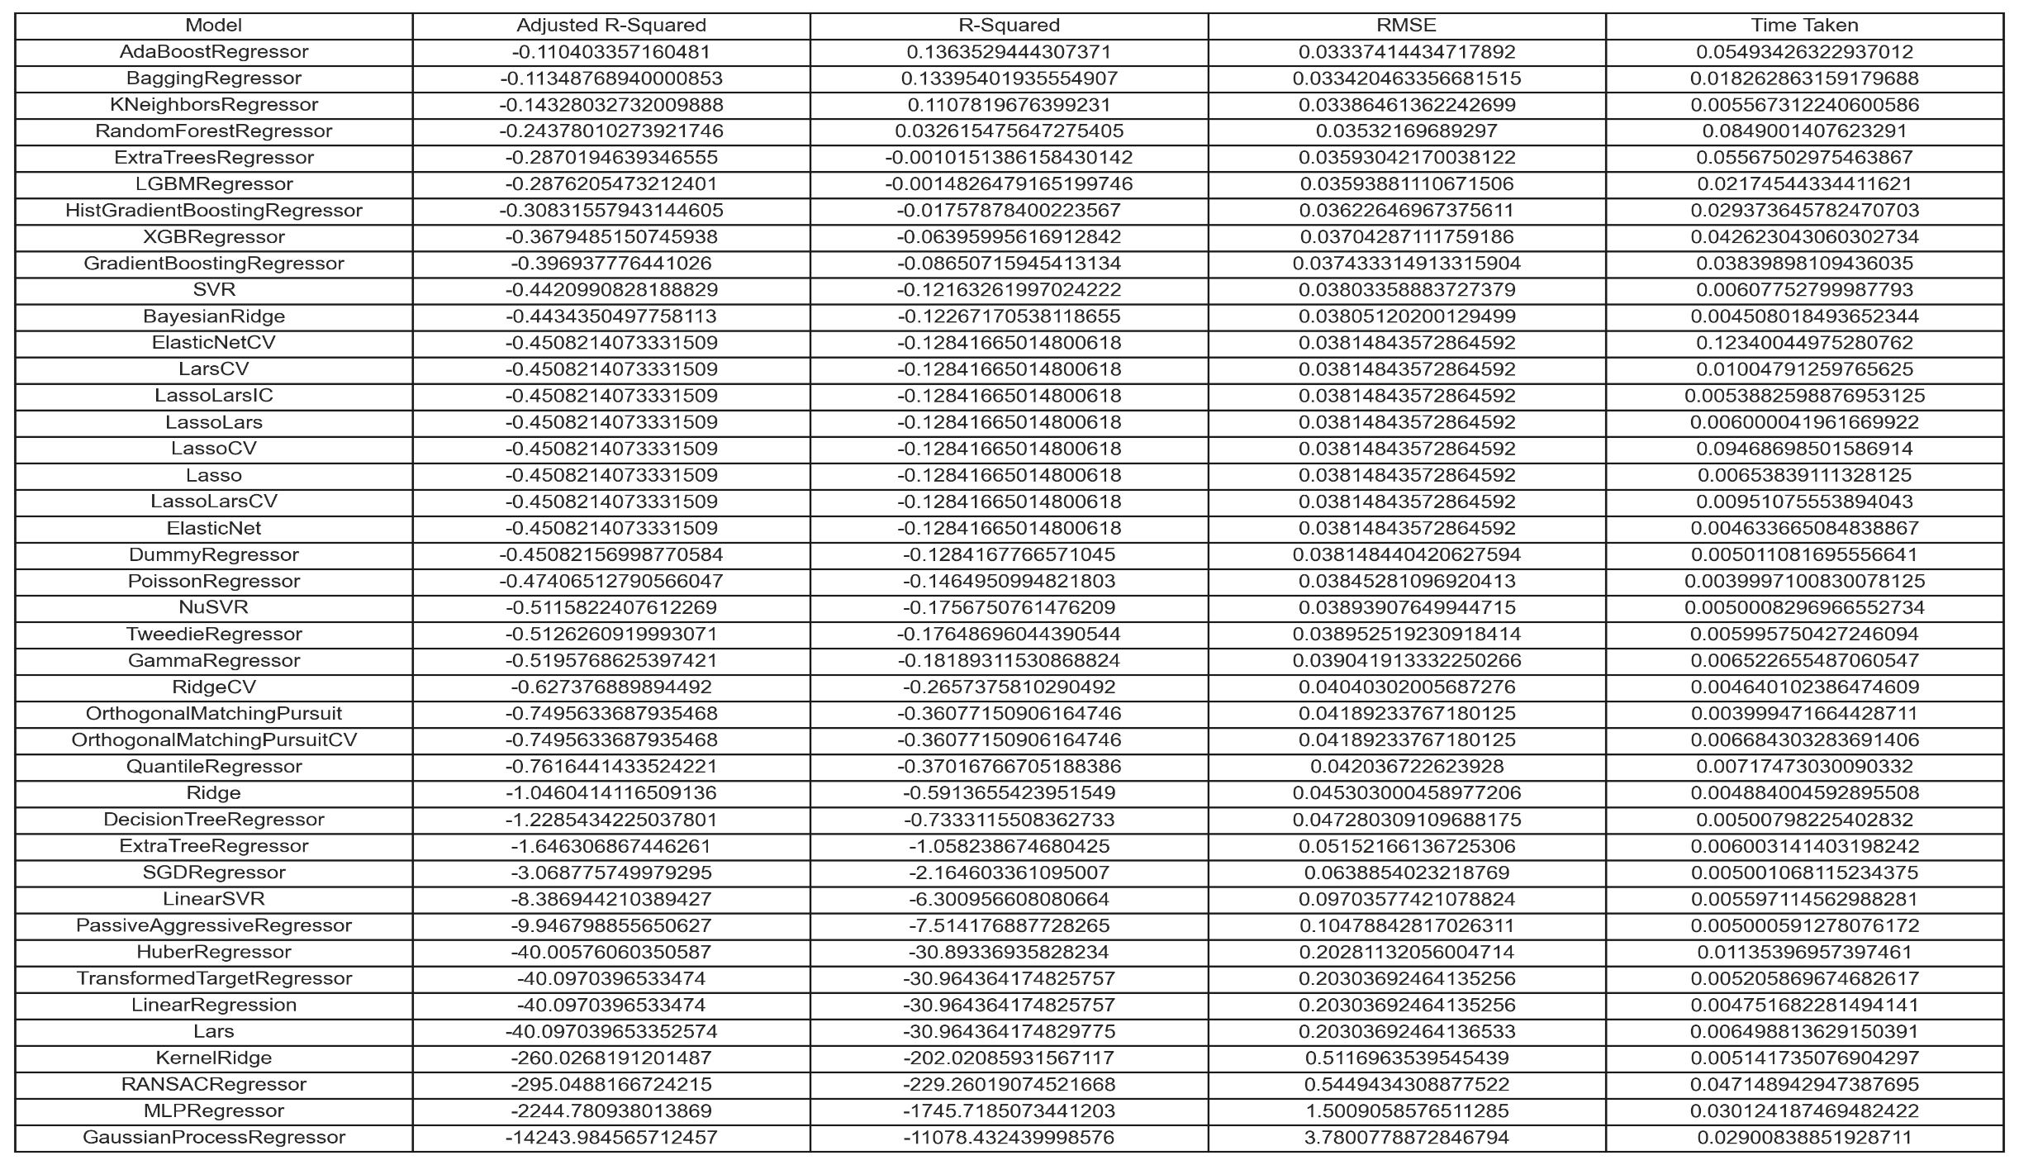
Lazy predict Results
Center C1 set1 speckle images:

Slide 26
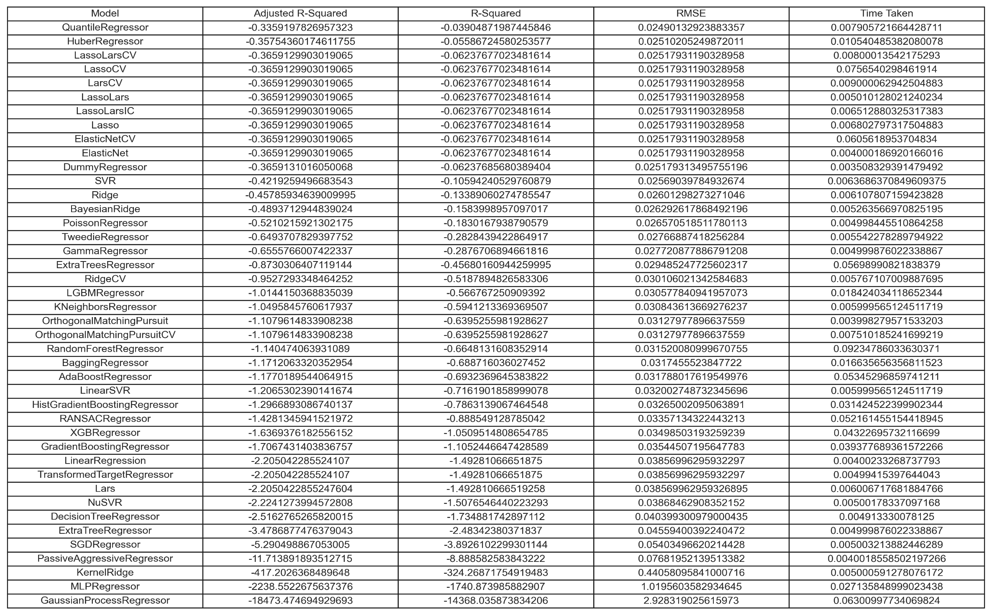
Lazy predict Results
Corner C1 set1 speckle images:

Slide 27
Future work
Extending the datasets to include more complex biological systems.
Integrating real-time monitoring with DLSI and ML by using Video frames directly for training instead of speckle images.
For complex non linear relationships and information loss in feature engineering, the hybrid quantum–classical 3D CNN framework can be used so that it leverages variational quantum algorithms (VQAs) to enhance the performance of classical models.
Exploring advanced techniques like transfer learning , ResNets etc..

Slide 28
Conclusion
This project demonstrates that deep learning models are effective in predicting continuous values of mean speckle contrast.
Role of Feature Engineering: Feature engineering was crucial in preparing structured data suitable for model training and evaluation.
Optimization through Hyperparameter Tuning:
ANN Model: GridSearchCV was instrumental in optimizing the ANN model by identifying its best parameters.
3D-CNN Model: The performance of 3D-CNN relied more on its architectural design (e.g., Conv3D and MaxPooling3D layers) than on hyperparameter tuning.
Performance Comparison:
ANN exhibited a slight advantage over 3D-CNN for structured and limited datasets.
The combination of ANN with FFT further enhanced its effectiveness.

Slide 29
References
•Dynamic Laser Speckle Imaging Meets Machine Learning to Enable Rapid Antibacterial Susceptibility Testing (DyRAST). (Dynamic Laser Speckle Imaging Meets Machine Learning to Enable Rapid Antibacterial Susceptibility Testing (DyRAST) | ACS Sensors)
•The Scientist and Engineer’s Guide to Digital Signal Processing – Steven W.smith, Ph.D. (https://www.dspguide.com/ch27/6.htm)
•Real time video rate perfusion imaging using multi-exposure laser speckle contrast imaging and machine learning. (https://doi.org/10.1117/1.JBO.25.11.116007)
•Can Laser Speckle Contrast Imaging be a quantitative measurement using Machine learning? (https://ieeexplore.ieee.org/document/10066755 )
•Quantum machine learning enhanced laser speckle analysis for precise speed prediction. (https://www.nature.com/articles/s41598-024-78884)
•Machine learning for interpreting coherent X-ray speckle pattern. (https://www.sciencedirect.com/science/article/pii/S0927025623004949)
•Machine Learning Forecasting of Active Nematics.

Slide 30

Thank you

